Slide 1
Operating System
(18CS43)

Slide 2
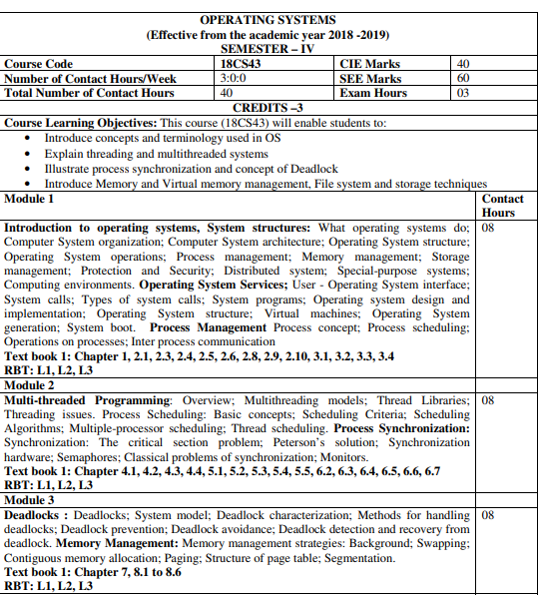
Syllabus

Slide 3
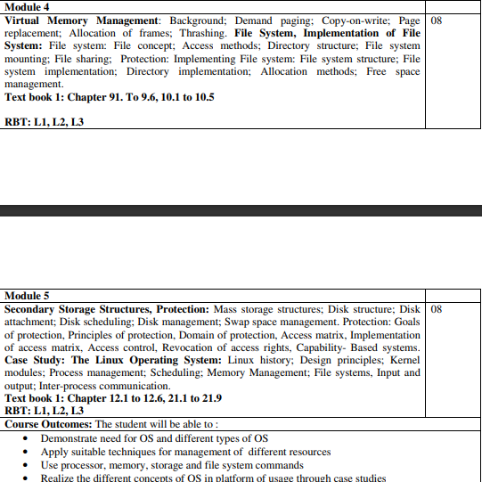
Syllabus

Slide 4
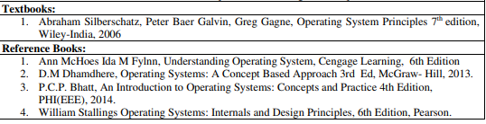
Book

Slide 5
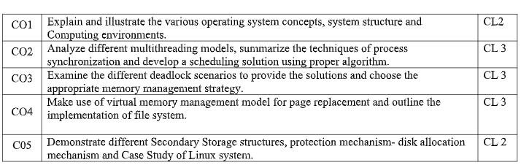
Course Outcome

Slide 6
The textbook
Operating System Concepts, 7th Edition Abraham Silberschatz, Yale University Peter Baer Galvin, Corporate Technologies Greg Gagne, Westminster College ISBN: 0-471-69466-5
http://he-cda.wiley.com/WileyCDA/HigherEdTitle/productCd-0471694665.html

Slide 7
Chapter 1-Overview
What Operating Systems Do
Computer-System Organization
Computer-System Architecture
Operating-System Structure
Operating-System Operations
Process Management
Memory Management
Storage Management
Protection and Security
Distributed Systems
Special-Purpose Systems
Computing Environments

Slide 8
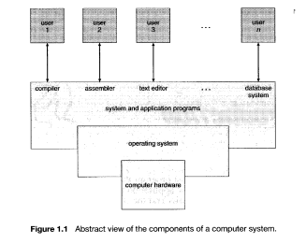
What Operating System Do
A computer system can be divided roughly into four components: the hardware, the operating system, the application programs, and the users (Figure 1.1).

Slide 9
Operating systems from two viewpoints
User View: The user's view of the computer varies according to the interface being used.
a monitor, keyboard, mouse, and system unit.
The goal is to maximize the work (or play) that the user is performing.
In this case, the operating system is designed mostly for ease of use, with some attention paid to performance and none paid to resource utilization-how various hardware and software resources are shared.
In other cases, a user sits at a terminal connected to a mainframe or minicomputer. Other users are accessing the same computer through other terminals.
In still other cases, users sit at workstations connected to networks of other workstations and servers.

Slide 10
Operating systems from two viewpoints
System View:From the computer's point of view, the operating system is the program most intimately involved with the hardware.
We can view an operating system as a resource allocator.
Manages all resources
Decides between conflicting requests for efficient and fair resource use.
A slightly different view of an operating system emphasizes the need to control the various I/O devices and user programs. An operating system is a control program.
Controls execution of programs to prevent errors and improper use of the computer

Slide 11
Defining Operating Systems
A program that acts as an intermediary between a user of a computer and the computer hardware.
Operating system goals:
Execute user programs and make solving user problems easier.
Make the computer system convenient to use.
Use the computer hardware in an efficient manner.

Slide 12
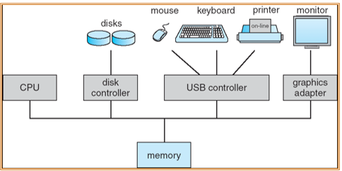
Computer-System Organization
Computer-System Operation
A modern general-purpose computer system consists of one or more CPUs and a number of device controllers connected through a common bus that provides access to shared memory.
The CPU and the device controllers can execute concurrently, competing for memory cycles
Figure 1.2 A modern computer system

Slide 13
Computer-System Organization
Computer-System Operation.
To ensure orderly access to the shared memory, a memory controller is provided whose function is to synchronize access to the memory.
For a computer to start running-for instance, when it is powered up or rebooted-it needs to have an initial program to run. This initial program, or bootstrap program.
The bootstrap program must know how to load the operating system and to start executing that system.
The operating system then starts executing the first process, such as "init," and waits for some event to occur.
The occurrence of an event is usually signaled by an interrupt from either the hardware or the software.
Hardware may trigger an interrupt at any time by sending a signal to the CPU, usually by way of the system bus.
Software may trigger an interrupt by executing a special operation called a system call (also called a monitor call)

Slide 14
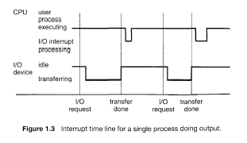
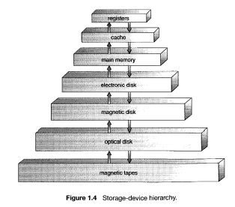
Computer-System Organization
When the CPU is interrupted, it stops what it is doing and immediately transfers execution to a fixed location.
Storage Structure
Computer programs must be in main memory (also called random-access memory or RAM) to be executed.

Slide 15
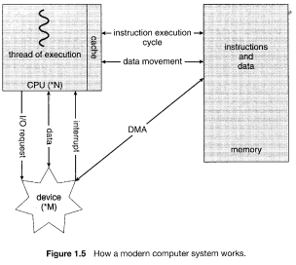
I/0 Structure
Storage is only one of many types of I/O devices within a computer. A large portion of operating system code is dedicated to managing I/O, both because of its importance to the reliability and performance of a system and because of the varying nature of the devices.
Direct memory access (DMA) is a feature of computer systems that allows certain hardware subsystems to access main system memory independently of the central processing unit (CPU)

Slide 16

Computer-System Architecture
In Section 1.2 we introduced the general structure of a typical computer system. A computer system may be organized in a number of different ways, which we can categorize roughly according to the number of general-purpose processors used.
Single-Processor Systems: Most systems use a single processor, On a single-processor system, there is one main CPU capable of executing a general-purpose instruction set, including instructions from user processes.
Multiprocessor Systems:Although single-processor systems are most common, multiprocessorsystems (also known as parallel systems or tightly coupled systems) are growing in importance.
Such systems have two or more processors in close communication, sharing the computer bus and sometimes the clock, memory, and peripheral devices.
Three main Advantages:
Increased Throughput
Economy of scale
Increased reliability

Slide 17
Clustered Systems
Another type of multiple-CPU system is the clustered system. Like multiprocessor systems, clustered systems gather together multiple CPUs to accomplish computational work.
The generally accepted definition is that clustered computers share storage and are closely linked via a local-area network (LAN) (as described in Section 1.10) or a faster interconnect such as InfiniBand.
Clustering is usually used to provide high-availability service, that is, service will continue even if one or more systems in the cluster fail. High availability is generally obtained by adding a level of redundancy in the system.
Clustering can be structured asymmetrically or symmetrically.
In asymmetric clustering, one machine is in hot-standby mode while the other is running the applications. The hot-standby host machine does nothing but monitor the active server. If that server fails, the hot-standby host becomes the active server.
In symmetric mode, two or more hosts are running applications, and are monitoring each other.

Slide 18
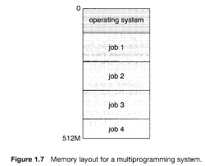
Operating-System Structure
An operating system provides the environment within which programs are executed.
One of the most important aspects of operating systems is the ability to multiprogram. A single user cannot, in general, keep either the CPU or the I/O devices busy at all times.
Multiprogramming increases CPU utilization by organizing jobs (code and data) so that the CPU always has one to execute.
Multiprogrammed systems provide an environment in which the various system resources (for example, CPU, memory, and peripheral devices) are utilized effectively.
Time sharing (or multitasking) is a logical extension of multiprogramming.
Time sharing requires an interactive (or hands-on) computer system, which provides direct communication between the user and the system.

Slide 19
Operating-System Operations
As mentioned earlier, modern operating systems are interrupt driven. If there are no processes to execute, no I/O devices to service, and no users to whom to respond, an operating system will sit quietly, waiting for something to happen.
Events are almost always signaled by the occurrence of an interrupt or a trap. A trap (or an exception) is a software-generated interrupt caused either by an error (for example, division by zero or invalid memory access) or by a specific request from a user program that an operating-system service be performed.

Slide 20
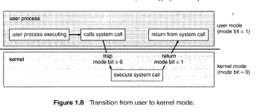
Operating-System Operations
Dual-Mode Operation:we need two separate modes of operation: user mode and kernel mode (also called supervisor mode, system mode, or privileged mode).
A bit, called the mode bit is added to the hardware of the computer to indicate the current mode: kernel (0) or user (1). With the mode bit, we are able to distinguish between a task that is executed on behalf of the operating system and one that is executed on behalf of the user

Slide 21
Operating-System Operations
Timer:
We must ensure that the operating system maintains control over the CPU.
We must prevent a user program from getting stuck in an infinite loop or not calling system services and never returning control to the operating system. To accomplish this goal, we can use a timer.
A timer can be set to interrupt the computer after a specified period. The period may be fixed (for example, 1/60 second) or variable (for example, from 1 millisecond to 1 second).
Thus, we can use the timer to prevent a user program from running too long. A simple technique is to initialize a counter with the amount of time that a program is allowed to run.

Slide 22
Process Management
A program in execution, as mentioned, is a process.
Process needs resources to accomplish its task
CPU, memory, I/O, files
Initialization data(input)
Process termination requires reclaim of any reusable resources
Single-threaded process has one program counter specifying location of next instruction to execute
Process executes instructions sequentially, one at a time, until completion
A process is the unit of work in a system. Such a system consists of a collection of processes.
Some of which are operating-system processes (those that execute system code)
The rest of which are user processes (those that execute user code)
The operating system is responsible for the following activities in connection with process management:
Creating and deleting both user and system processes
Suspending and resuming processes
Providing mechanisms for process synchronization
Providing mechanisms for process communication
Providing mechanisms for deadlock handling

Slide 23
Memory Management
The main memory is central to the operation of a modern computer system. Main memory is a large array of words or bytes ranging in size from hundreds of thousands to billions.
Main memory is a repository of quickly accessible data shared by the CPU and I/O devices.
The central processor reads instructions from main memory during the instruction-fetch cycle and both reads and writes data from main memory during the data-fetch cycle.
The operating system is responsible for the following activities in connection with memory management
Keeping track of which parts of memory are currently being used and by whom
Deciding which processes (or parts thereof) and data to move into and out of memory
Allocating and deallocating memory space as needed

Slide 24
Storage Management
The operating system provides a uniform, logical view of information storage.
Abstracts physical properties to logical storage unit - file
Each medium is controlled by device (i.e., disk drive, tape drive)
Varying properties include access speed, capacity, data-transfer rate, access method (sequential or random).
File-System management
Files usually organized into directories
Access control on most systems to determine who can access what
The operating system is responsible for the following activities in connection with file management.
Creating and deleting files
Creating and deleting directories to organize files
Supporting primitives for manipulating files and directories
Mapping files onto secondary storage
Backing up files on stable (nonvolatile) storage media

Slide 25
Mass-storage Management
Usually disks used to store data that does not fit in main memory or data that must be kept for a “long” period of time.
Proper management is of central importance
Entire speed of computer operation hinges on disk subsystem and its algorithms
The operating system is responsible for the following activities in connection with disk management:
Storage allocation
Free-space management
Disk scheduling
Some storage need not be fast
Tertiary storage includes optical storage, magnetic tape
Still must be managed
Varies between WORM (write-once, read-many-times) and RW (read-write)

Slide 26
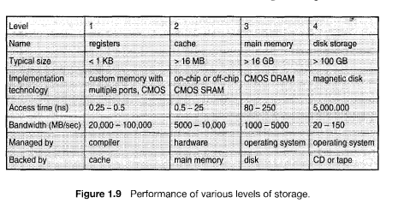
Caching
Caching is an important principle of computer systems. Information is normally kept in some storage system (such as main memory). As it is used, it is copied into a faster storage system-the cache-on a temporary basis.
Because caches have limited size, cache management is an important design problem. Careful selection of the cache size and of a replacement policy can result in greatly increased performance

Slide 27
I/O Systems
One of the purposes of an operating system is to hide the peculiarities of specific hardware devices from the user. For example, in UNIX, the peculiarities of I/O devices are hidden from the bulk of the operating system itself by the I/O subsystem.
A memory-management component that includes buffering, caching, and spooling
A general device-driver interface
Drivers for specific hardware devices
Only the device driver knows the peculiarities of the specific device to which it is assigned.

Slide 28
Protection and Security
If a computer system has multiple users and allows the concurrent execution of multiple processes, then access to data must be regulated.
For that purpose, mechanisms ensure that files, memory segments, CPU, and other resources can be operated on by only those processes that have gained proper authorization from the operating system.
Protection, then, is any mechanism for controlling the access of processes or users to the resources defined by a computer system. This mechanism must provide means for specification of the controls to be imposed and means for enforcement.
A system can have adequate protection but still be prone to failure and allow inappropriate access. Consider a user whose authentication information (her means of identifying herself to the system) is stolen. Her data could be copied or deleted, even though file and memory protection are working.
It is the job of security to defend a system from external and internal attacks. Such attacks spread across a huge range and include viruses and worms, denial-of service attacks (which use all of a system's resources and so keep legitimate users out of the system), identity theft, and theft of service (unauthorized use of a system).

Slide 29
Distributed Systems
A distributed system is a collection of physically separate, possibly heterogeneous computer systems that are networked to provide the users with access to the various resources that the system maintains.
A network, in the simplest terms, is a communication path between two or more systems. They are characterized based on the distances between their nodes.
LAN (Connects computers within a room, a floor or a building), WAN (links buildings, cities or countries) & MAN (link buildings within a city)
Some operating systems have taken the concept of network and distributed systems further than the notion of providing network connectivity (network operating systems)

Slide 30
Special-Purpose Systems
There are, however, different classes of computer systems whose functions are more limited and whose objective is to deal with limited computation domains.
Real – Time Embedded Systems (Embedded Systems are the most prevalent form of computers in existence. These devices are found everywhere, from car engines to and manufacturing robots to DVDs and microwave ovens)
Multimedia systems (Most OS are designed to handle conventional data such as text files, programs, word-processing documents and spreadsheets. However a recent trend in technology is the incorporation of multimedia data (audio, video files and conventional files)
Handheld Systems (Include personal digital assistants(PDA), such as palm and pocket –Pcs and cellular telephones).

Slide 31
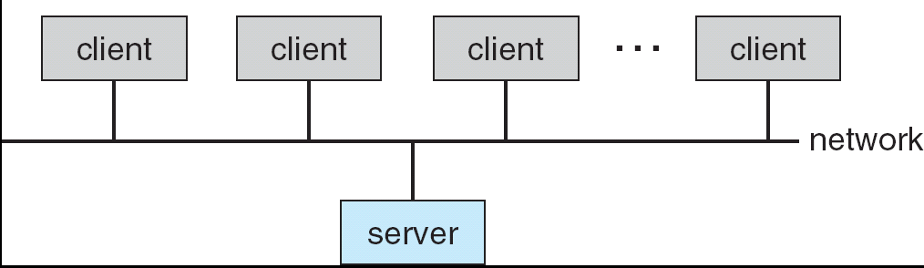
Computing Environments
Traditional computer
Blurring over time
Office environment
PCs connected to a network, terminals attached to mainframe or minicomputers providing batch and timesharing
Now portals allowing networked and remote systems access to same resources
Home networks
Used to be single system, then modems
Now firewalled, networked
Client-Server Computing
Many systems now servers, responding to requests generated by clients
Compute-server provides an interface to client to request services (i.e. database)
File-server provides interface for clients to store and retrieve files

Slide 32
Computing Environments
Peer-to-Peer Computing
Web-Based Computing
Another model of distributed system
P2P does not distinguish clients and servers
Instead all nodes are considered peers
May each act as client, server or both
Node must join P2P network
Registers its service with central lookup service on network, or
Broadcast request for service and respond to requests for service via discovery protocol
Web has become ubiquitous
PCs most prevalent devices
More devices becoming networked to allow web access
New category of devices to manage web traffic among similar servers: load balancers
Use of operating systems like Windows 95, client-side, have evolved into Linux and Windows XP, which can be clients and servers

Slide 33
Chapter2
Operating System Structures

Slide 34
Chapter 2 -Overview
User - Operating System interface
System calls; Types of system calls
System programs
Operating system design and implementation
Operating System structure
Virtual machines
Operating System generation
System boot.

Slide 35
Operating-System Services
An operating system provides an environment for the execution of programs. It provides certain services to programs and to the users of those programs.
One set of operating-system services provides functions that are helpful to the user.
User interface - Almost all operating systems have a user interface (UI)
Varies between Command-Line (CLI), Graphics User Interface (GUI), Batch
Program execution - The system must be able to load a program into memory and to run that program, end execution, either normally or abnormally (indicating error)
I/O operations - A running program may require I/O, which may involve a file or an I/O device.
File-system manipulation - The file system is of particular interest. Obviously, programs need to read and write files and directories, create and delete them, search them, list file Information, permission management.
5. Communications – Processes may exchange information, on the same computer or between computers over a network. Communications may be via shared memory or through message passing (packets moved by the OS)
6. Error detection – OS needs to be constantly aware of possible errors ,May occur in the CPU and memory hardware, in I/O devices, in user program

Slide 36
Operating-System Services
Another set of operating-system functions exists not for helping the user but rather for ensuring the efficient operation of the system itself
Resource allocation - When multiple users or multiple jobs running concurrently, resources must be allocated to each of them
Many types of resources - Some (such as CPU cycles, main memory, and file storage) may have special allocation code, others (such as I/O devices) may have general request and release code.
Accounting - To keep track of which users use how much and what kinds of computer resources
Protection and security - The owners of information stored in a multiuser or networked computer system may want to control use of that information, concurrent processes should not interfere with each other
Protection involves ensuring that all access to system resources is controlled
Security of the system from outsiders requires user authentication, extends to defending external I/O devices from invalid access attempts
If a system is to be protected and secure, precautions must be instituted throughout it. A chain is only as strong as its weakest link.

Slide 37
User Operating-System Interlace
Command Interpreter:CLI allows direct command entry
Sometimes implemented in kernel, sometimes by systems program
Sometimes multiple flavors implemented – shells
Primarily fetches a command from user and executes it
Sometimes commands built-in, sometimes just names of programs
Graphical User Interfaces:User-friendly desktop metaphor interface
Usually mouse, keyboard, and monitor
Icons represent files, programs, actions, etc
Various mouse buttons over objects in the interface cause various actions (provide information, options, execute function, open directory (known as a folder).
The first GUI appeared on the Xerox Alto computer in 1973.

Slide 38
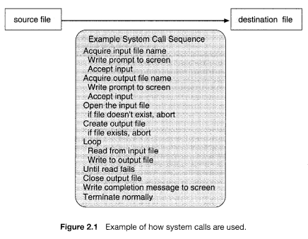
System Calls
Programming interface to the services provided by the OS
Typically written in a high-level language (C or C++)
Mostly accessed by programs via a high-level Application Program Interface (API) rather than direct system call use
Three most common APIs are Win32 API for Windows, POSIX API for POSIX-based systems (including virtually all versions of UNIX, Linux, and Mac OS X), and Java API for the Java virtual machine (JVM)
let's first use an example to illustrate how system calls are used: writing a simple program to read data from one file and copy them to another file.

Slide 39
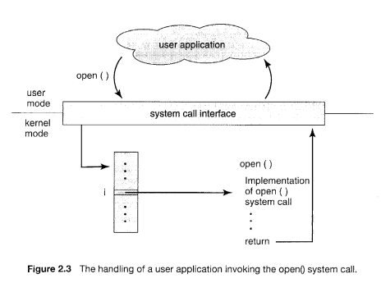
Handling of user application invoking the open() system call
The run-time support system (a set of functions built into libraries included with a compiler) for most programming languages provides a system-call interface that serves as the link to system calls made available by the operating system.

Slide 40
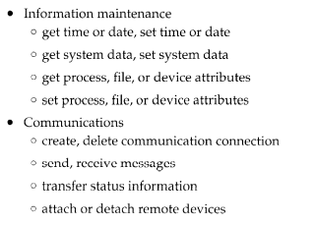
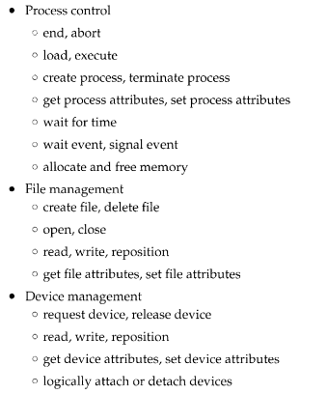
Types of System Calls
System calls can be grouped roughly into five major categories: process control, file manipulation, device manipulation, information maintenance, and communications.

Slide 41
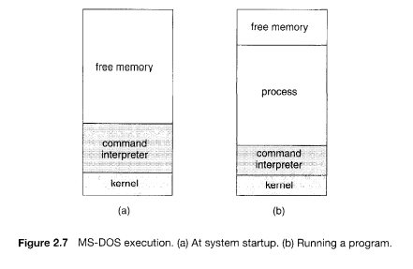
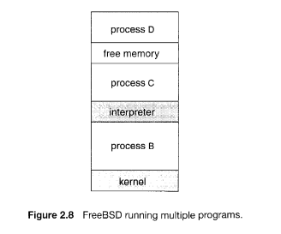
MS-DOS Execution and FreeBSD allowing multiple task

Slide 42
System Programs
Another aspect of a modern system is the collection of system programs.
File management. These programs create, delete, copy, rename, print, dump, list, and generally manipulate files and directories.
Status information. Some programs simply ask the system for the date, time, amount of available memory or disk space, number of users, or similar status information. Others are more complex, providing detailed performance, logging, and debugging information.
File modification. Several text editors may be available to create and modify the content of files stored on disk or other storage devices
Programming-language support. Compilers, assemblers, debuggers and interpreters for common programming languages (such as C, C++, Java, Visual Basic, and PERL) are often provided to the user with the operating system.
Program loading and execution. Once a program is assembled or com~ piled, it must be loaded into memory to be executed. The system may provide absolute loaders, relocatable loaders, linkage editors, and overlay loaders
Communications. These programs provide the mechanism for creating virtual connections among processes, users, and computer systems

Slide 43
Operating-System Design and Implementation
We discuss problems we face in designing and implementing an operating system.
Design Goals: The first problem in designing a system is to define goals and specifications. At the highest level, the design of the system will be affected by the choice of hardware and the type of system: batch, time shared, single user, multiuser, distributed, real time, or general purpose.
Another problem will be in specifying requirements, The requirements can, however, be divided into two basic groups: user goals and system goals.
User goals – operating system should be convenient to use, easy to learn, reliable, safe, and fast
System goals – operating system should be easy to design, implement, and maintain, as well as flexible, reliable, error-free, and efficient

Slide 44
Operating-System Design and Implementation
Mechanisms and Policies:One important principle is the separation of policy from mechanism.
Mechanisms determine how to do something; policies determine what will be done. For example, the timer construct (see Section 1.5.2) is a mechanism for ensuring CPU protection, but deciding how long the timer is to be set for a particular user is a policy decision.
The separation of policy from mechanism is a very important principle, it allows maximum flexibility if policy decisions are to be changed later
Implementation:Once an operating system is designed, it must be implemented. Traditionally, operating systems have been written in assembly language. Now, however, they are most commonly written in higher-level languages such as C or C++.
The Linux and Windows XP operating systems are written mostly in C

Slide 45
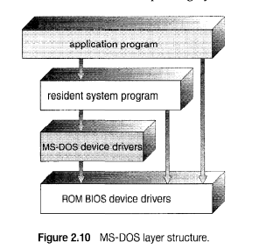
Operating-System Structure
Simple Structure:MS-DOS – written to provide the most functionality in the least space
Not divided into modules
Although MS-DOS has some structure, its interfaces and levels of functionality are not well separated.

Slide 46
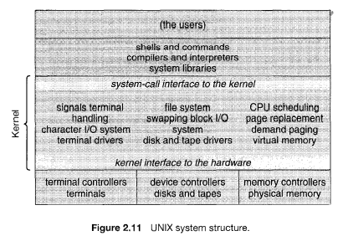
UNIX OS structure
Everything below the system call interface and above the physical hardware is the kernel. The kernel provides the file system, CPU scheduling, memory management, and other operating-system functions through system calls. Taken in sum, that is an enormous amount of functionality to be combined into one level. This monolithic structure was difficult to implement and maintain

Slide 47
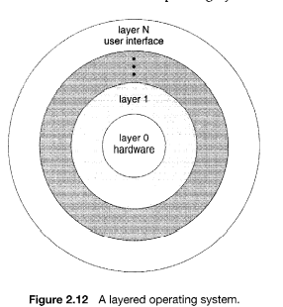
Layered Approach
The operating system is divided into a number of layers (levels), each built on top of lower layers. The bottom layer (layer 0), is the hardware; the highest (layer N) is the user interface.
With modularity, layers are selected such that each uses functions (operations) and services of only lower-level layers.
An operating-system layer is an implementation of an abstract object made up of data and the operations that can manipulate those data.
A typical operating-system layer-say, layer M-consists of data structures and a set of routines that can be invoked by higher-level layers. Layer M, in turn, can invoke operations on lower-level layers.

Slide 48
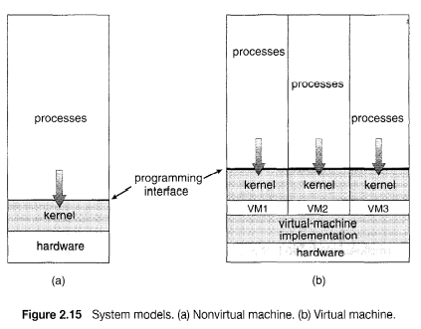
Virtual Machines
The fundamental idea behind a virtual machine is to abstract the hardware of a single computer (the CPU, memory, disk drives, network interface cards, and so forth) into several different execution environments, thereby creating the illusion that each separate execution environment is running its own private computer.
By using CPU scheduling and virtual-memory techniques an operating system can create the illusion that a process has its own processor with its own (virtual) memory.
There are several reasons for creating a virtual machine, all of which are fundamentally related to being able to share the same hardware yet run several different execution environments (that is, different operating systems) concurrently.

Slide 49
Examples
Home work for students: case study on 1. Vmware 2. The Java Virtual Machine

Slide 50
Operating-System Generation
Operating systems are designed to run on any of a class of machines; the system must be configured for each specific computer site
SYSGEN program obtains information concerning the specific configuration of the hardware system
Booting – starting a computer by loading the kernel
Bootstrap program – code stored in ROM that is able to locate the kernel, load it into memory, and start its execution.
The SYSGEN determines-What CPU is to be used? • How much memory is available? • What devices are available?. • What operating-system options are desired, or what parameter values are to be used?

Slide 51
System Boot
Operating system must be made available to hardware so hardware can start it
Small piece of code – bootstrap loader, locates the kernel, loads it into memory, and starts it
Sometimes two-step process where boot block at fixed location loads bootstrap loader
When power initialized on system, execution starts at a fixed memory location
Firmware used to hold initial boot code

Slide 52
Chapter 3
Process Management

Slide 53
Chapter 3-Overview
Process concept
Process scheduling
Operations on processes
Inter process communication

Slide 54
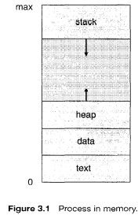
Process Concept
A process can be thought of as a program in execution. A process will need certain resources-such as CPU time, memory, files, and I/O devices -to accomplish its task. These resources are allocated to the process either when it is created or while it is executing.
A process is the unit of work in most systems. Systems consist of a collection of processes: Operating system processes execute system code, and user processes execute user code.
Text Section:A process is more than the program code
Program Counter(PC):current activity, Represented by value of PC
Process Stack: which contains temporary data (such as function parameters, return addresses, and local variables).
Data Section: which contains global variables
Heap: which is memory that is dynamically allocated during process run time

Slide 55
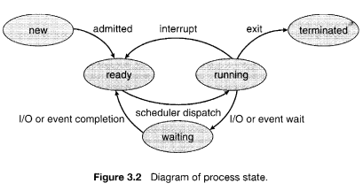
Process State
As a process executes, it changes state. The state of a process is defined in part by the current activity of that process. Each process may be in one of the following states:
• New. The process is being created.
• Running. Instructions are being executed.
• Waiting. The process is waiting for some event to occur (such as an I/O completion or reception of a signal).
• Ready. The process is waiting to be assigned to a processor.
• Terminated. The process has finished execution.

Slide 56
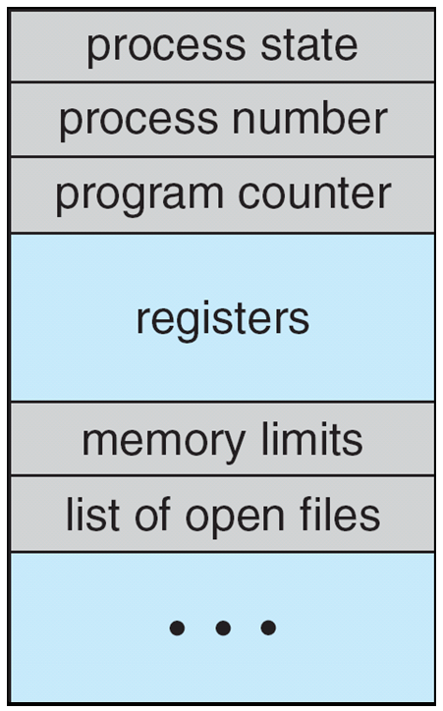
Process Control Block-Each process is represented in the operating system
Process state. The state may be new, ready, running, waiting, halted, and so on.
Program counter. The counter indicates the address of the next instruction to be executed for this process.
• CPU registers. The registers vary in number and type, depending on the computer architecture. They include accumulators, index registers, stack pointers, and general-purpose registers
• CPU-scheduling information. This information includes a process priority, pointers to scheduling queues, and any other scheduling parameters.
•Memory-management information. This information may include such information as the value of the base and limit registers, the page tables, or the segment tables, depending on the memory system used by the operating system
• Accounting information. This information includes the amount of CPU and real time used, time limits, account numbers, job or process numbers, and so on.
• I/O status information. This information includes the list of I/O devices allocated to the process, a list of open files, and so on.
Figure 3.3 Process control block (PCB)

Slide 57
Threads
A thread is a single sequential flow of execution of tasks of a process so it is also known as thread of execution or thread of control.
There is a way of thread execution inside the process of any operating system. Apart from this, there can be more than one thread inside a process.
So far, process has a single thread of execution
Consider having multiple program counters per process
Multiple locations can execute at once
Multiple threads of control -> threads
Must then have storage for thread details, multiple program counters in PCB.

Slide 58
Process Scheduling
The objective of multiprogramming is to have some process running at all times, Maximize CPU use, quickly switch processes onto CPU for time sharing
Process scheduler selects among available processes for next execution on CPU.
Maintains scheduling queues of processes
As processes enter the system, they are put into a job queue, which consists of all processes in the system.
The processes that are residing in main memory and are ready and waiting to execute are kept on a list called the ready queue.
Device queues – set of processes waiting for an I/O device
Processes migrate among the various queues

Slide 59
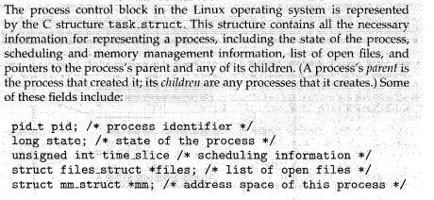
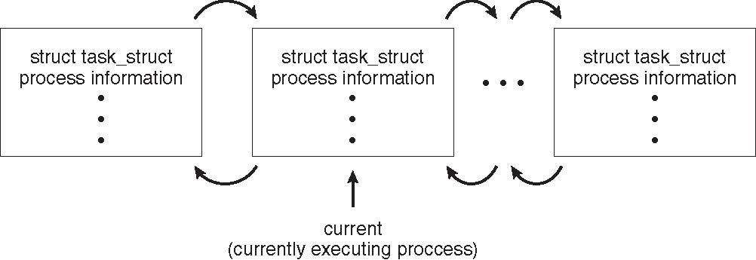
Process Scheduling

Slide 60
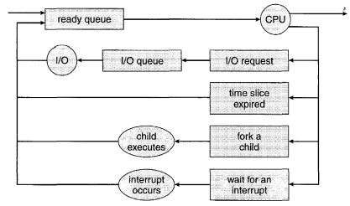
Process Scheduling
A common representation for a discussion of process scheduling is a queueing diagram shown in Fig 3.7.
Each rectangular box represents a queue. Two types of queues are present: the ready queue and a set of device queues.
The circles represent the resources that serve the queues, and the arrows indicate the flow of processes in the system.
A new process is initially put in the ready queue. It waits there until it is selected for execution, or is dispatched. Once the process is allocated the CPU and is executing, one of several events could occur:
The process could issue an I/O request and then be placed in an I/O queue.
The process could create a new subprocess and wait for the subprocess's termination.
The process could be removed forcibly from the CPU, as a result of an interrupt, and be put back in the ready queue.
Figure 3.7 Queueing-diagram representation of process scheduling.

Slide 61
Schedulers
Short-term scheduler (or CPU scheduler) – selects which process should be executed next and allocates CPU
Sometimes the only scheduler in a system
Short-term scheduler is invoked frequently (milliseconds) ⇒ (must be fast)
Long-term scheduler (or job scheduler) – selects which processes should be brought into the ready queue
Long-term scheduler is invoked infrequently (seconds, minutes) ⇒ (may be slow)
The long-term scheduler controls the degree of multiprogramming
Medium-term scheduler can be added if degree of multiple programming needs to decrease
Remove process from memory, store on disk, bring back in from disk to continue execution: swapping.
most processes can be described as either I/O bound or CPU bound. An I/O-bound process is one that spends more of its time doing I/O than it spends doing computations. A CPU bound process
Context Switching?

Slide 62
Operations on Processes
Parent process create children processes, which, in turn create other processes, forming a tree of processes
Generally, process identified and managed via a process identifier (pid)
Resource sharing options
Parent and children share all resources
Children share subset of parent’s resources
Execution options
Parent and children execute concurrently
Parent waits until children terminate
Figure 3.8 :A Tree of Processes in Linux

Slide 63
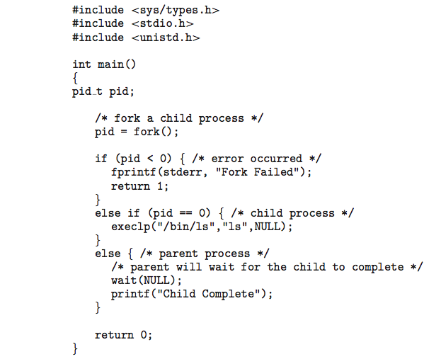
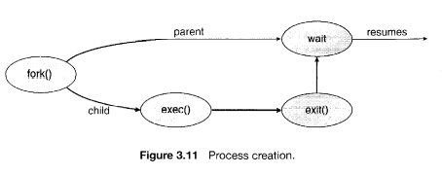
C Program Forking Separate Process

Slide 64
Process Termination
A process terminates when it finishes executing its final statement and asks the operating system to delete it by using the exit () system call.
A parent may terminate the execution of one of its children for a variety of reasons, such as these:
The child has exceeded its usage of some of the resources that it has been allocated.
The task assigned to the child is no longer required.
The parent is exiting, and the operating system does not allow a child to continue if its parent terminates.

Slide 65
Interprocess Communication
Processes within a system may be independent or cooperating
Cooperating process can affect or be affected by other processes, including sharing data
Reasons for cooperating processes:
Information sharing
Computation speedup
Modularity
Convenience
Cooperating processes need interprocess communication (IPC)
Two models of IPC
Shared memory
Message passing

Slide 66
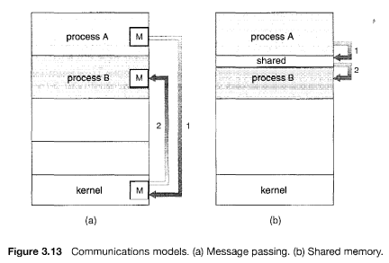
IPC Mechanism
(1) shared memory and (2) message passing.
In the shared-memory model, a region of memory that is shared by cooperating processes is established. Processes can then exchange information by reading and writing data to the shared region.
In the message passing model, communication takes place by means of messages exchanged between the cooperating processes. The two communications models are contrasted in Figure 3.13.

Slide 67
Shared-Memory Systems
Interprocess communication using shared memory requires communicating processes to establish a region of shared memory.
Other processes that wish to communicate using this shared-memory segment must attach it to their address space.
To illustrate the concept of cooperating processes, let's consider the producer-consumer problem, which is a common paradigm for cooperating processes.
A producer process produces information that is consumed by a consumer process. For example, a compiler may produce assembly code, which is consumed by an assembler. The assembler, in turn, may produce object modules, which are consumed by the loader.
One solution to the producer-consumer problem uses shared memory. To allow producer and consumer processes to run concurrently, we must have available a buffer of items that can be filled by the producer and emptied by the consumer.

Slide 68
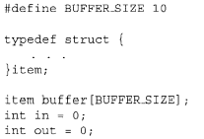
Producer-Consumer Problem-Shared Memory
The following variables reside in a region of memory shared by the producer and consumer processes
item next_produced;
while (true) {
/* produce an item in next produced */
while (((in + 1) % BUFFER_SIZE) == out)
; /* do nothing */
buffer[in] = next_produced;
in = (in + 1) % BUFFER_SIZE;
}
Figure 3.14 The producer process.
item next_consumed;
while (true) { while (in == out)
; /* do nothing */ next_consumed = buffer[out];
out = (out + 1) % BUFFER_SIZE;
/* consume the item in next consumed */
}
Figure 3.15 The consumer process

Slide 69
Message-Passing Systems
Message passing provides a mechanism to allow processes to communicate and to synchronize their actions without sharing the same address space and is particularly useful in a distributed environment, where the communicating processes may reside on different computers connected by a network.
A message-passing facility provides at least two operations: send(message) and receive(message). Messages sent by a process can be of either fixed or variable size.
If processes P and Q want to communicate, they must send messages to and receive messages from each other; a communication link must exist between them.
Here are several methods for logically implementing a link and the send/receive operations:
Direct or indirect communication
Synchronous or asynchronous communication
Automatic or explicit buffering

Slide 70
Message-Passing Systems Continued
Naming: Processes that want to communicate must have a way to refer to each other. They can use either direct or indirect communication.
Under direct communication, each process that wants to communicate must explicitly name the recipient or sender of the communication. In this scheme, the send () and receive () primitives are defined as: • send(P, message) -Send a message to process P. • receive (Q, message) -Receive a message from process Q.
A variant of this scheme employs asymmetry in addressing. Here, only the sender names the recipient; the recipient is not required to name the sender. In this scheme, the send () and receive () primitives are defined as follows: • send(P, message) -Send a message to process P. • receive (id, message) -Receive a message from any process; the variable id is set to the name of the process with which communication has taken place

Slide 71
Message-Passing Systems Continued
With indirect communication, the messages are sent to and received from mailboxes, or ports. A mailbox can be viewed abstractly as an object into which messages can be placed by processes and from which messages can be removed.
In this scheme, a process can communicate with some other process via a number of different mailboxes. Two processes can communicate only if the processes have a shared mailbox, however. The send() and receive () primitives are defined as follows: send (A, message) -Send a message to mailbox A. • receive (A, message) -Receive a message from mailbox A.
The operating system then must provide a mechanism that allows a process to do the following: • Create a new mailbox. • Send and receive messages through the mailbox. • Delete a mailbox.

Slide 72
Message-Passing Systems Continued
Synchronization:Communication between processes takes place through calls to send () and receive () primitives. There are different design options for implementing each primitive. :Message passing may be either blocking or nonblocking also known as synchronous and asynchronous.
Blocking send. The sending process is blocked until the message is received by the receiving process or by the mailbox.
Nonblocking send. The sending process sends the message and resumes operation.
Blocking receive. The receiver blocks until a message is available.
Nonblocking receive. The receiver retrieves either a valid message or a null.
Buffering
Whether communication is direct or indirect, messages exchanged by communicating processes reside in a temporary queue. Basically, such queues can be implemented in three ways:
Zero capacity. The queue has a maximum length of zero; thus, the link cannot have any messages waiting in it. In this case, the sender must block until the recipient receives the message.
Bounded capacity. The queue has finite length n
Unbounded capacity. The queues length is potentially infinite; thus, any number of messages can wait in it. The sender never blocks

Slide 73
References
Abraham Silberschatz, Peter Baer Galvin, Greg Gagne, Operating System Principles 7th edition, Wiley-India, 2006
Ann McHoes Ida M Fylnn, Understanding Operating System, Cengage Learning, 6th Edition

